Slide 1






Environmental Risk Assessment of Veterinary Medicines
-
VICH
guidelines
Ricardo Carapeto García
Environmental Risk Assessor – VetMeds
Spanish Medicines Agency
November 2021

Slide 2


Environmental Risk Assessment (ERA) – International Governance
ERA principles are defined in an international framework (VICH)
Two basic guidelines: VICH GL 6 & VICH GL 38
Step-wise approach: Phase I and Phase II ERA

Slide 3
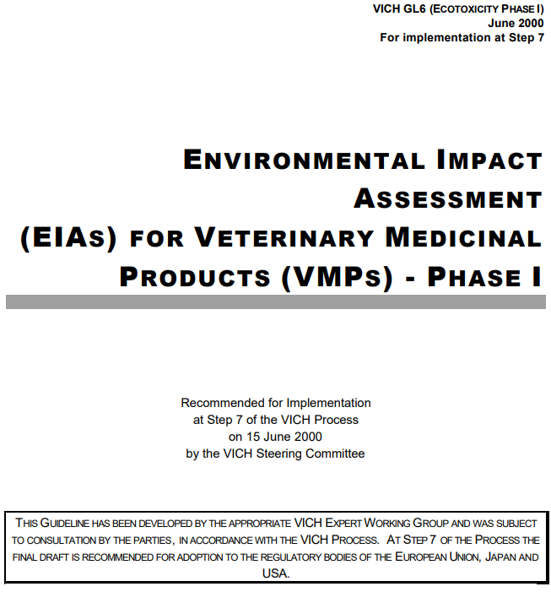
Phase I ERA
GL06 Environmental Ieuropa.eumpact Assessment for VMPs - Step 7 ()

Slide 4
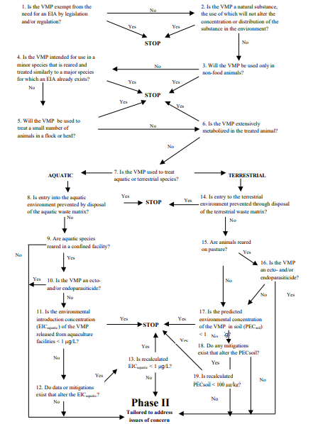

Phase I ERA
Based on exposure
  Low exposure → Limited risk
  Individual treatments → Phase I
  Pets → Phase I
  Natural substances → Phase I (¿?)
  Exposure < 100 µg/kg → Phase I
But also on specific issues:
  Parasiticides → Phase II
  Aquaculture open waters → Phase II
“However clause”

Slide 5
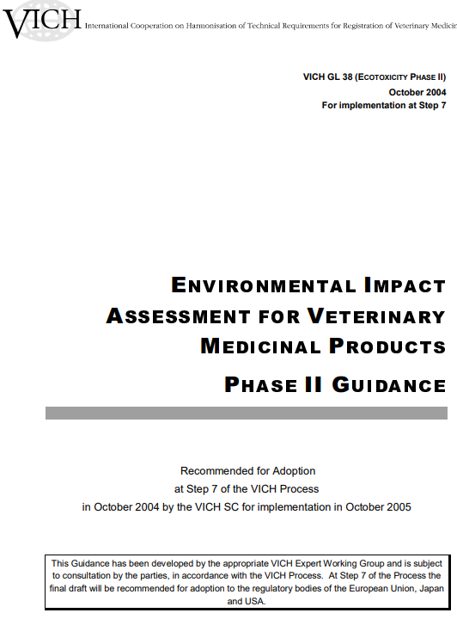
Phase II ERA
https://vichsec.org/en/component/attachments/attachments/311.html?task=download

Slide 6
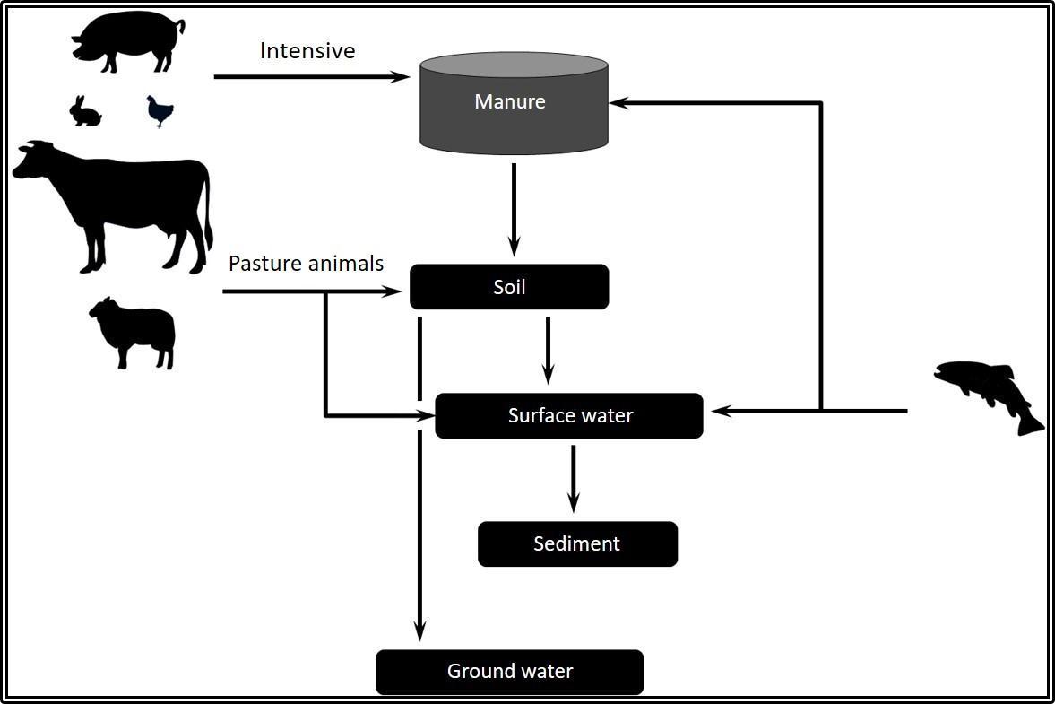
Phase II ERA

Slide 7



Phase II ERA
2
PROBLEM FORMULATION
RISK MANAGEMENT
1
RISK ASSESSMENT
3

Slide 8
Phase II ERA
Problem formulation – Protection goals
  Protection of ecosystems
Risk assessment
  Exposure calculation (PEC)
  Toxicity determination (PNEC)
  Risk Quotient Approach → RQ= PEC/PNEC

Slide 9

Phase II ERA
Exposure calculation
  Husbandry practices
  Physicochemical / fate and behavior studies
Toxicity determination
  Environmental compartments
    Soil
    Water (freshwater or saltwater)
    Dung
    Sediment

Slide 10
Phase II ERA
Tiered Approach:
RQ < 1
STOP
Tier A
Exposure refinement
RQ < 1
STOP
RQ ≥ 1
RQ ≥ 1
Tier B

Slide 11
Phase II ERA
Physicochemical (solubility, log Kow, pKa…)
Fate and behavior (Adsorption, soil degradation)
Toxicity
  Soil: Earthworms, plants, bacteria
  Water: Algae, aquatic invertebrates, fish
  Sediment: Sediment invertebrate
  Dung: Dung flies and dung beetles
  Salt water: Algae, crustacean, fish

Slide 12





¡Thank you for your attention!

